Slide 1
DPPHA 30560
Data Visualization
Week 5, Color and Annotation

Slide 2
Annotation

Slide 3
Annotation
Could be the most important layer in data viz.

Slide 4
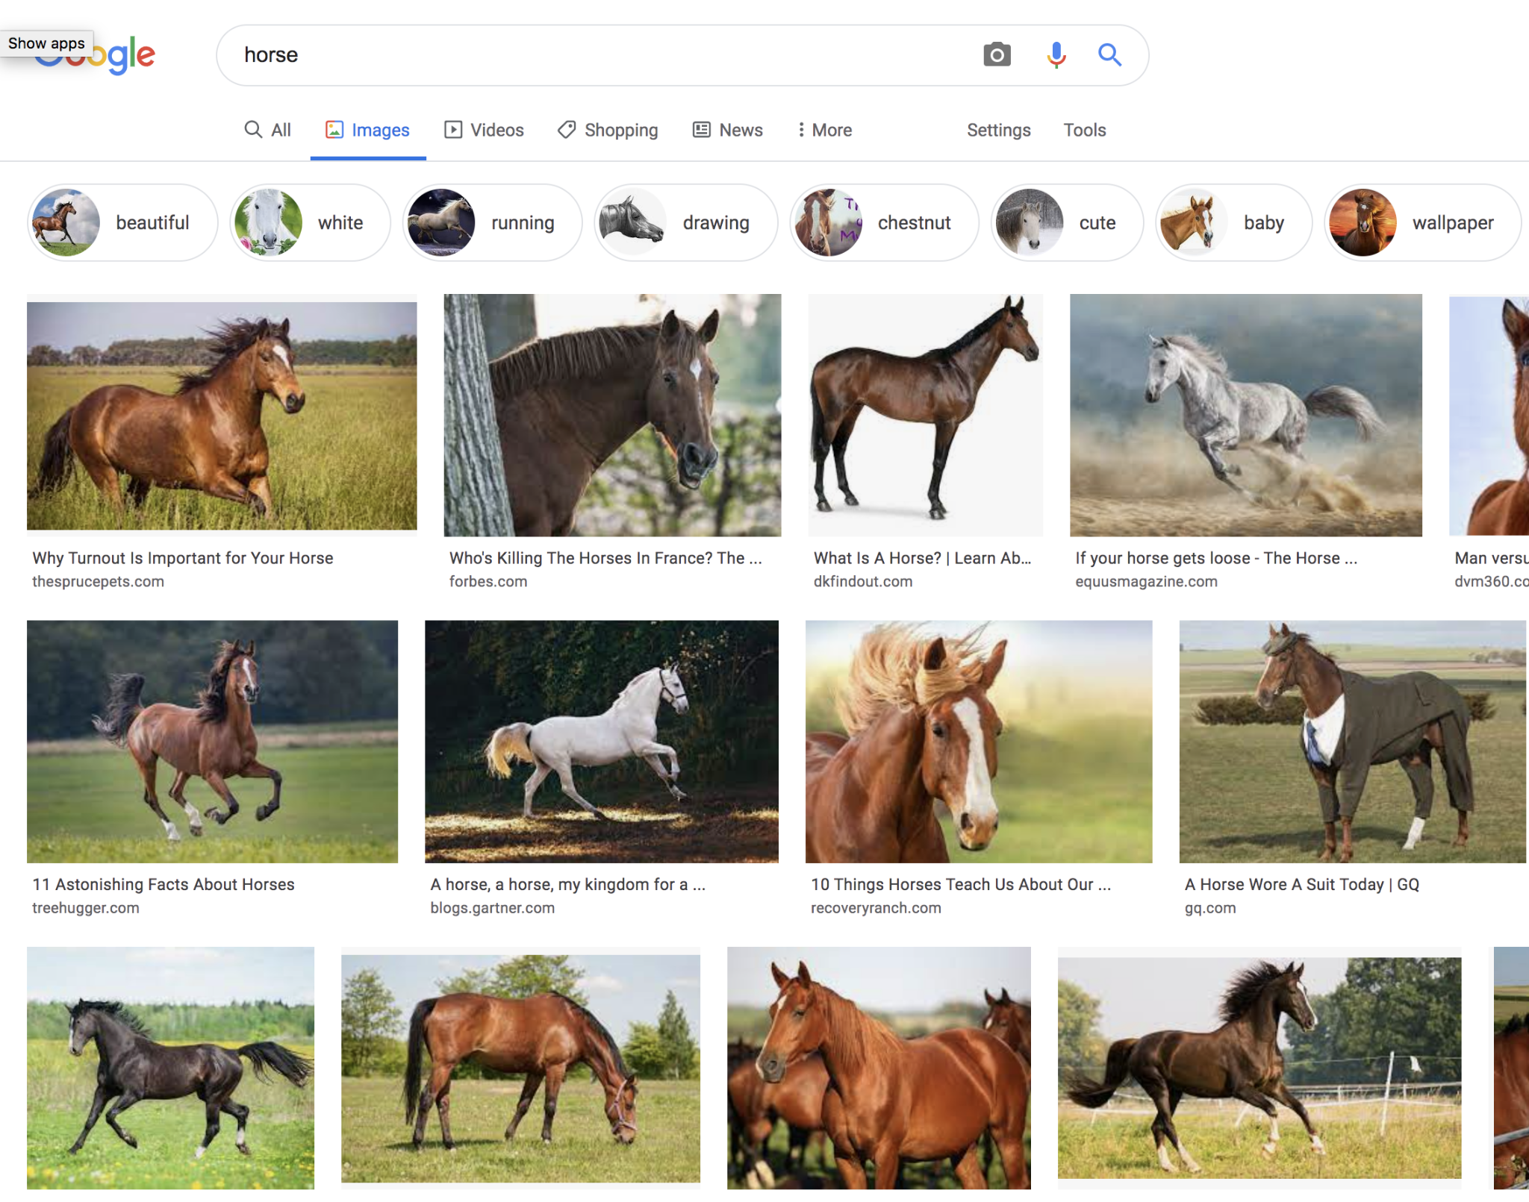
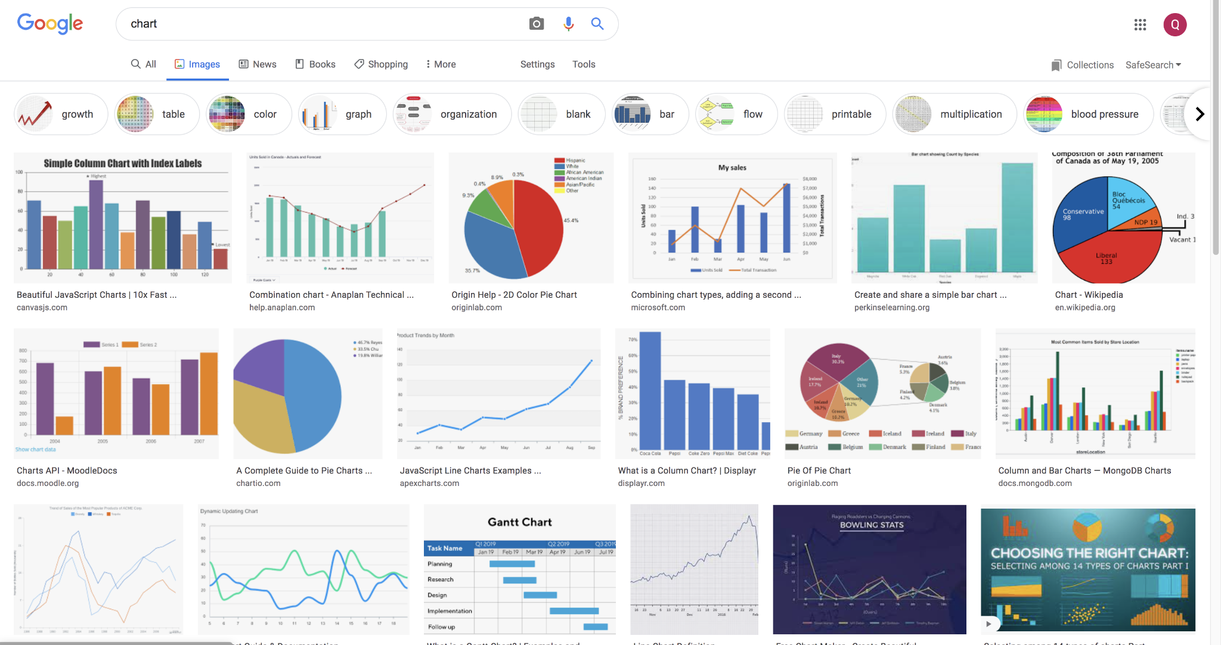
Annotation
There is nothing like a chart that exists in the real world.
Even though it is visual, the pictorial expression of a chart represents nothing.

Slide 5
Annotation
Every chart is a vision of a new world.
It’s your job as a designer to describe the contours of that world and help people learn the richness of that world.

Slide 6
Example
What is Healthy?

Slide 7
Example
How 2 M.T.A. Decisions
Pushed the Subway Into Crisis

Slide 8
Annotations
Good annotation reinforce accurate interpretations.
You can also add a “perspective layer”
A layer of words that reframe that units on a more human/intuitive level.

Slide 9
Example
Drug Deaths in America Are Rising Faster Than Ever

Slide 10
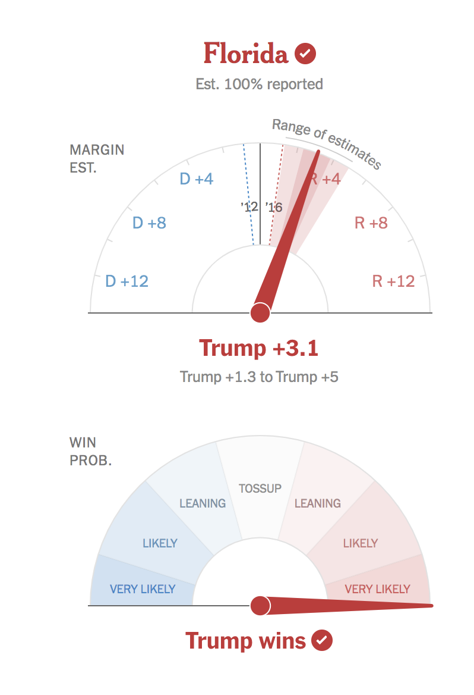
Annotations
Example: probability is hard.

Slide 11
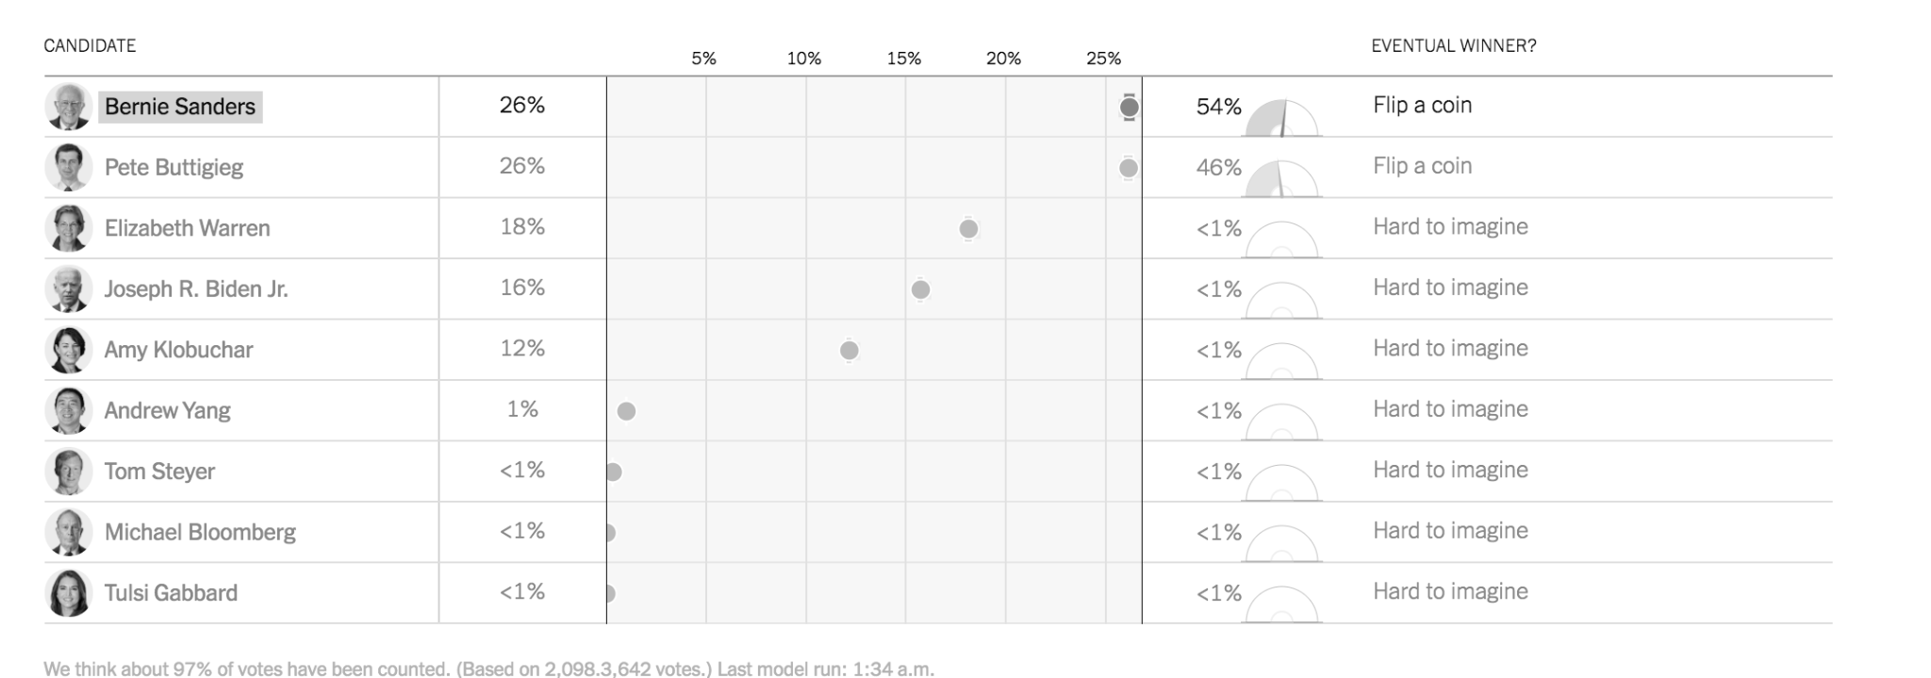
Annotations
Example: probability is hard.

Slide 12
Annotations
My colleagues spend a lot of time thinking about units.

Slide 13
Tips on annotation
Use words that are human.
Keep it as conversational as possible
Don’t be afraid to repeat yourself
Don’t play fetch. Place the annotation where the action is.

Slide 14
Colors

Slide 15
Add meaning, not just decorative
Good colors emphasize
They prime understanding
Good colors group
It’s nice to make beautiful things

Slide 16
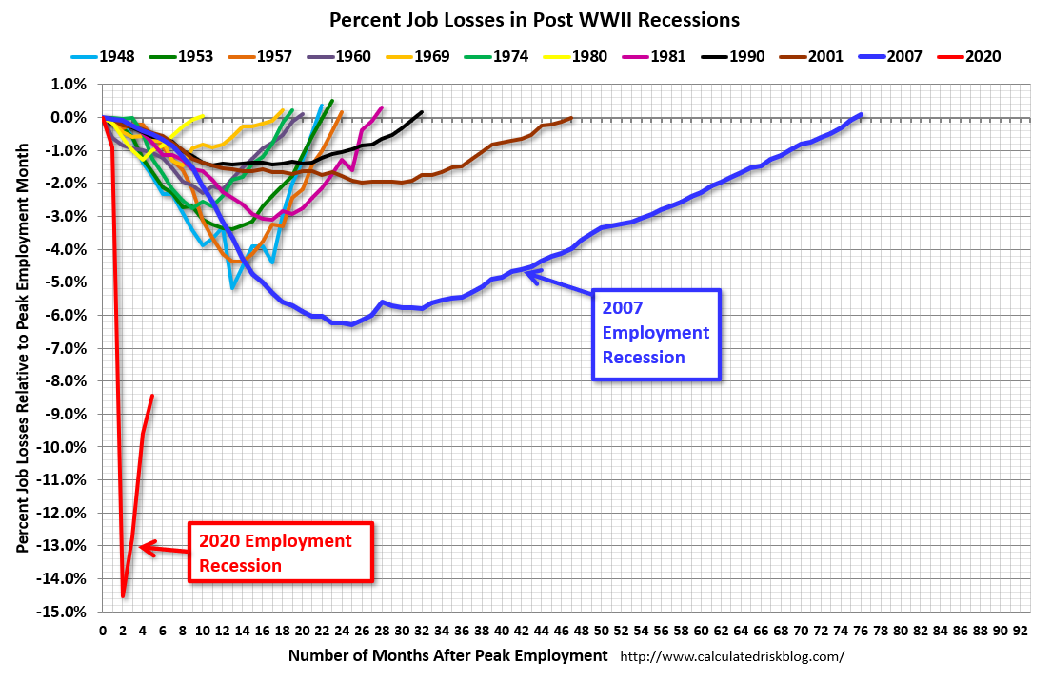
What’s going on here?
Notes:
This is a kind of chart that gets made a lot. We are not going to make this chart.
What is this chart missing?

Slide 17
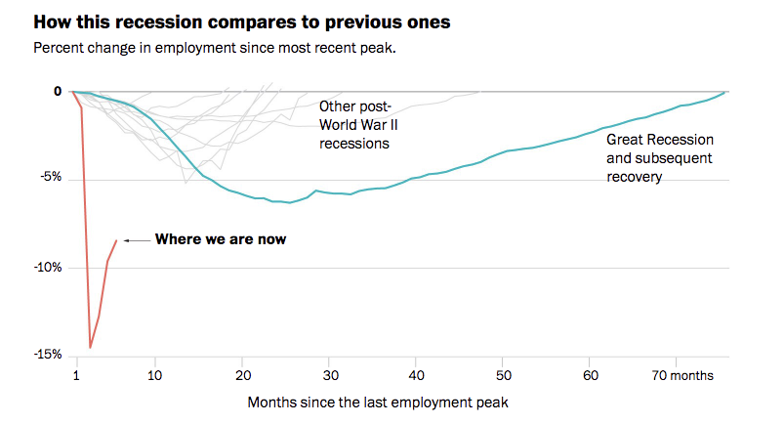
Notes:
What is different?

Slide 18
Colors are hard
Colors are relational. Read Josef Albers.
There are lots of models of color for computer graphics. The most common ones are HSV (hue, saturation, value), HSL (hue, saturation, lightness), and HCL (hue, chroma, lightness).
You could do a very long lecture/entire class on the technical details of these color models.
In practice you can be effective with just a few color rules.

Slide 19
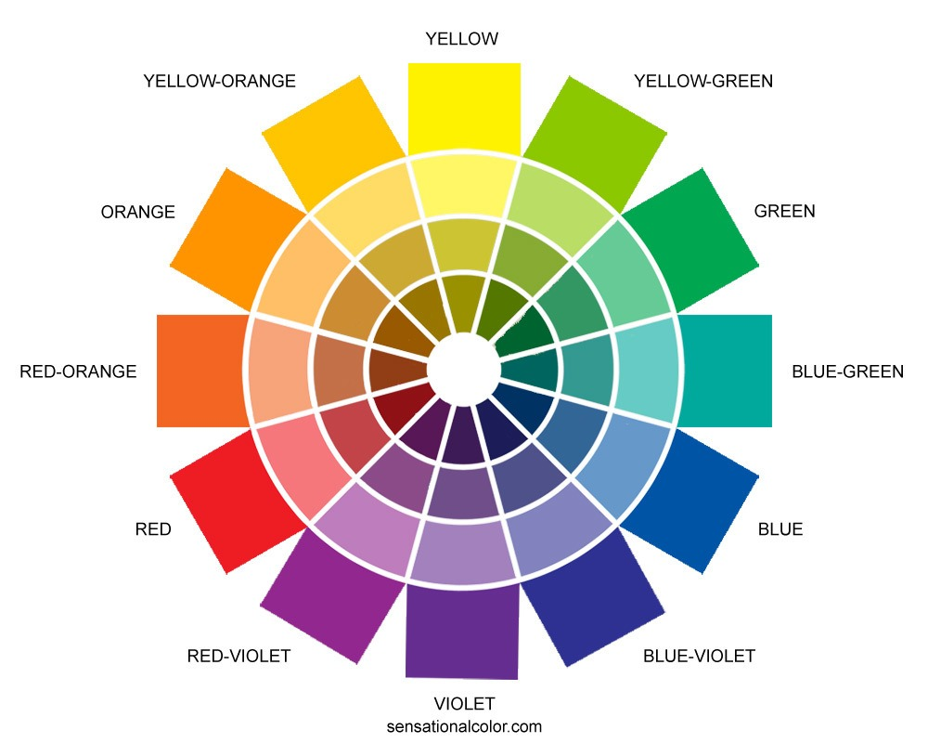
Color wheel
Don’t jump all over the color wheel.

Slide 20
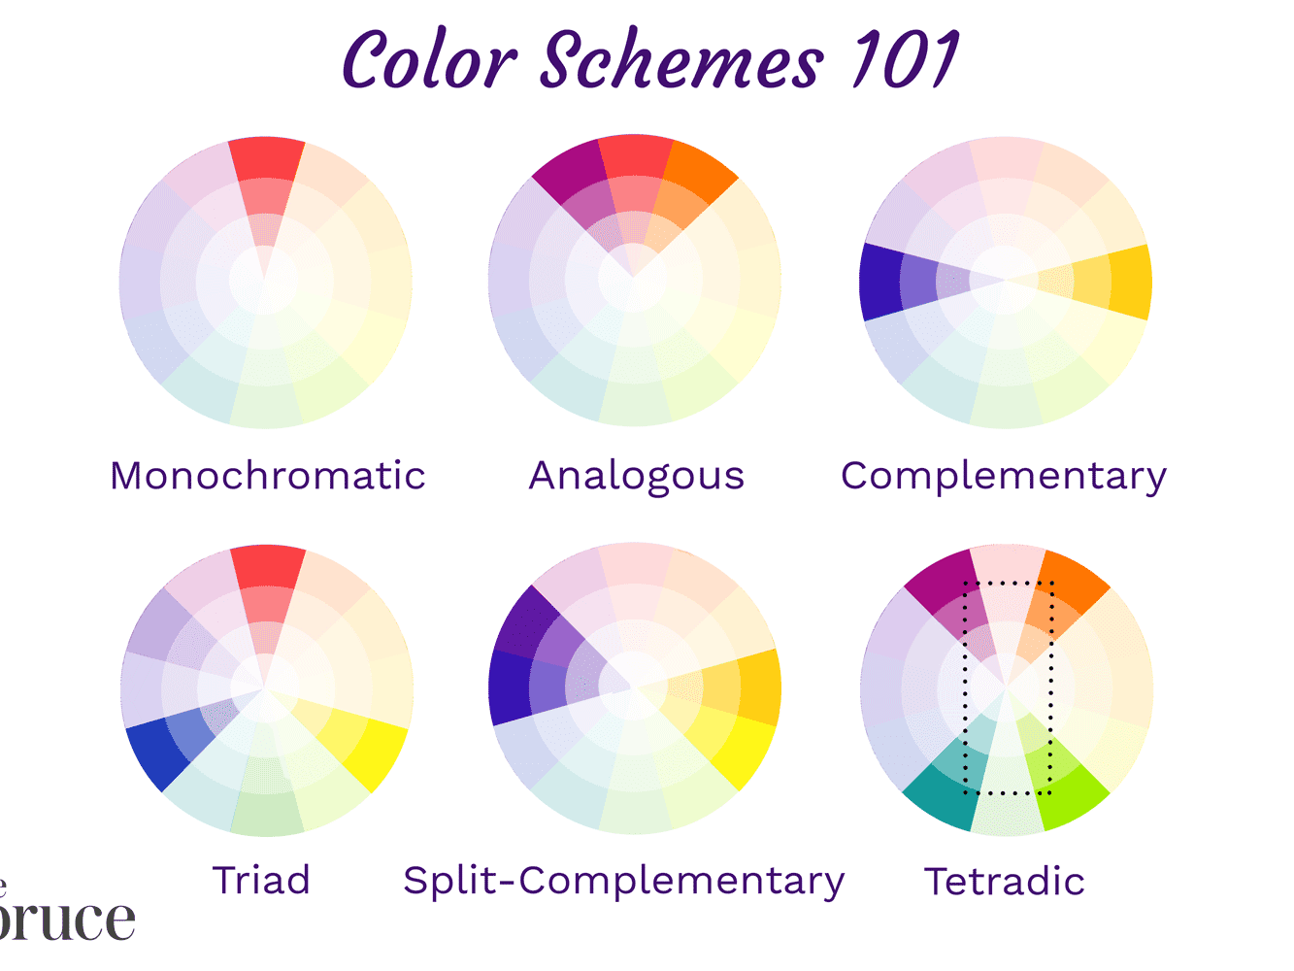
Color wheel
Try to use the color harmonies.
Don’t use tetradic.
Don’t go full saturation.
Colors should suggest meaning. So similar groups should stay in the similar family.
Avoid double encoding.
If feature already has data, don’t add color
X

Slide 21
Don’t fight intuition
Colors have intuitive meaning
Red is loss / green is gain
Red is hot / blue is cool
Don’t resist these obvious connotations. But don’t need to go into a rabbit hole.
In the US. Blue = DEM, Red = GOP
Avoid that combo unless you’re talking about politics.
But there is a difference between intuitive meanings and stereotypes:
Blue for boys and pink for girls

Slide 22
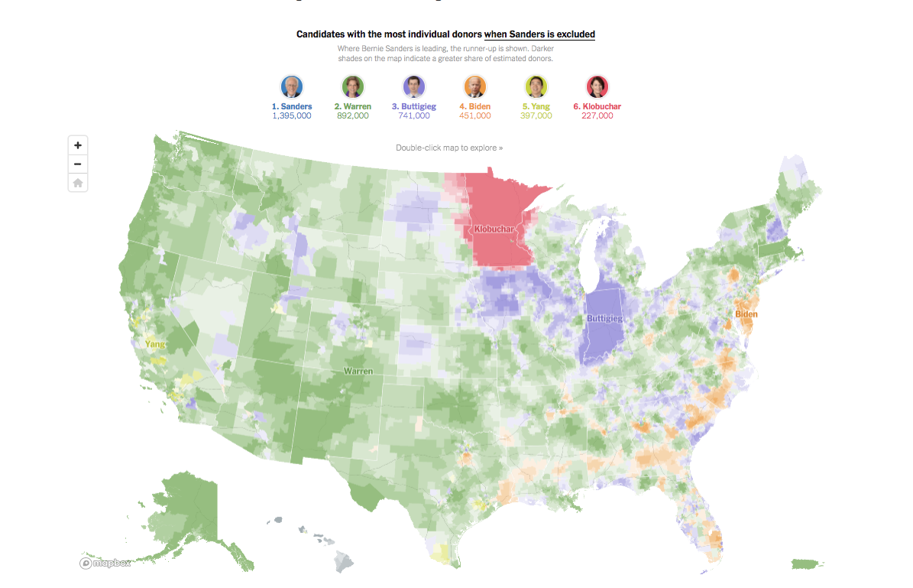
Avoid many colors
You’re in bad shape if you’re working with more than 5 colors.
This was very hard to get right:
Notes:
https://www.nytimes.com/interactive/2020/02/01/us/politics/democratic-presidential-campaign-donors.html

Slide 23
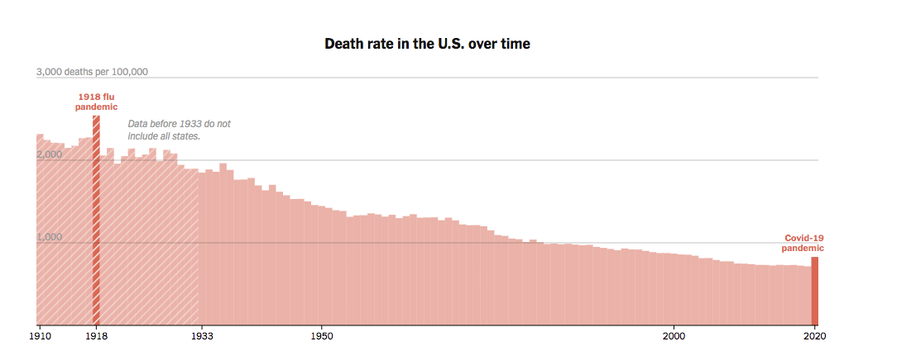
Opacity
Opacity can emphasize. Sometimes you don’t want to change the color because you don’t want to signal a conceptual change.

Slide 24
Opacity
Overplotting can be seen as a problem, but if you use opacity correctly then it can actually add data.

Slide 25
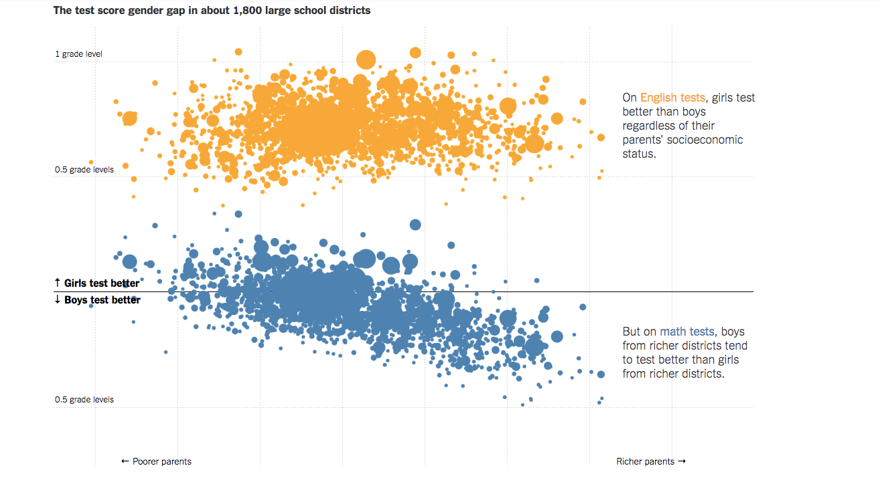
Example
Where Boys Outperform Girls in Math: Rich, White and Suburban Districts

Slide 26
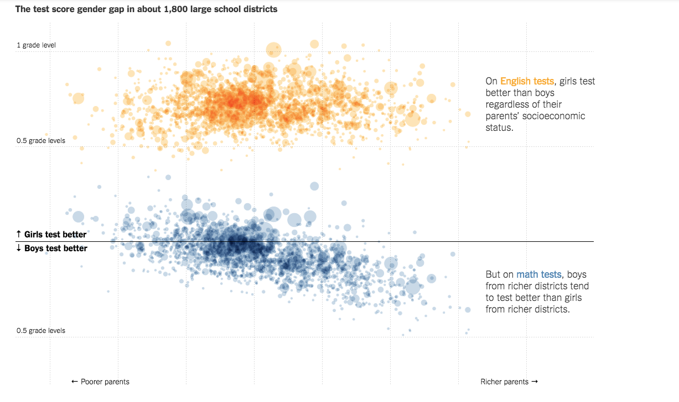
Example
Where Boys Outperform Girls in Math: Rich, White and Suburban Districts

Slide 27
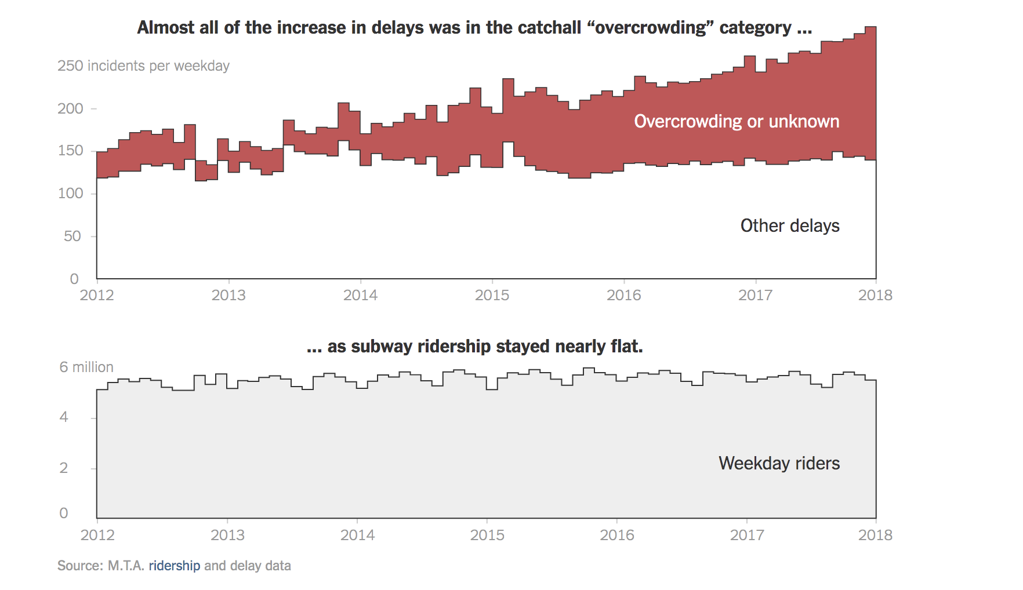
Grey and beige are your friends
They sit in the back as reference
Give context
But don’t dominate the conversation

Slide 28
Perceptual hierarchy
Balanced
Not all beige.
Not all lightly shaded.
Something is emphasized in front.
Something is supporting in the back.

Slide 29
Color-blindedness
Be aware. 5 to 10% of the U.S. population, mostly men
Avoid red/green.
Use colorblind extensions.

Slide 30

Feeling lazy?
Use Colorbrewer
Designed by Cynthia Brewer
Her palettes avoid many pitfalls with perception and color blindness
D3 color schemes
Material Design
Colorizer if you want to see all the color models.
Paletton
Adobe Color Wheel

Slide 31
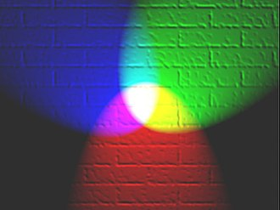
RGB model
In digital work color can be expressed as in 3 colors Red, Green and Blue.
Each color gets 255 values
“rgb(255, 255, 255)” = white
“rgb(0,0,0)” = black
On the web, we use hex colors as shorthand for certain colors.
The algorithm for converting rgb to hex is fascinating
There are built in HTML color names
Notes:
Burlywood

Slide 32
Print vs Digital
Digital work will be in the RGB color model
Printed work is in CMYK = Cyan, Magenta, Yellow, and Key = Black
If you’re designing in RGB but intend to publish in print, make sure you’re in the right color space.
If you’re in print, make sure you’re using at most 3 plates, and that all your black text is 100% K

Slide 33
Final Project
Due May 31st. One day before our last lecture.
It can be original work or a reworking from something published.
The chart (or charts) need to tell a compelling story.
This is where it all comes together: sketching, hierarchy, ticks, annotation, form, color and design come together.
You will not be graded on technical achievement, but the overall effectiveness of the graphic.
Note:
It needs to be done in D3.
Does not necessarily need to be interactive.
Can be one data visualization or a suite of data visualization.
Do not mix forms. Find a form and play with it.

